Slide 1




How Does a Multilingual LM Handle Multiple Languages?
Shashwat Bhardwaj
2023AIY7528
Tony Stark
AIL821 | Large Language Models (LLMs): Introduction and Recent Advances | IIT-Delhi

Slide 2
TABLE OF CONTENTS
Introduction
Task-1
Task-2
Task-3
Future Scope of Improvement

Slide 3
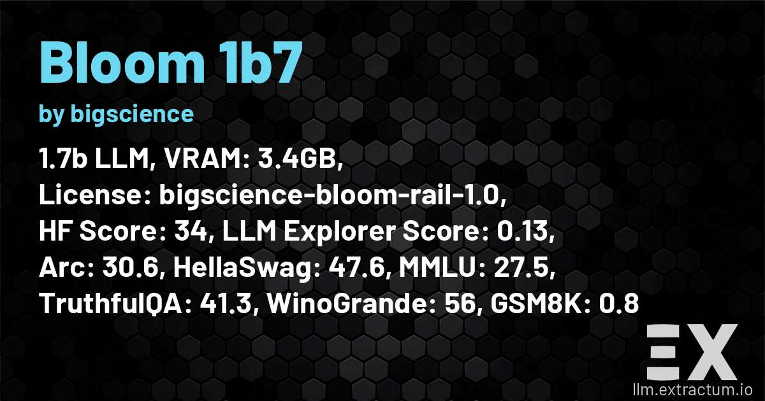
INTRODUCTION
The project was aimed to understand how multiple languages are processed by a multilingual language model BLOOM 1.7B in our case and whether they have the ability to transfer knowledge across languages or not

Slide 4
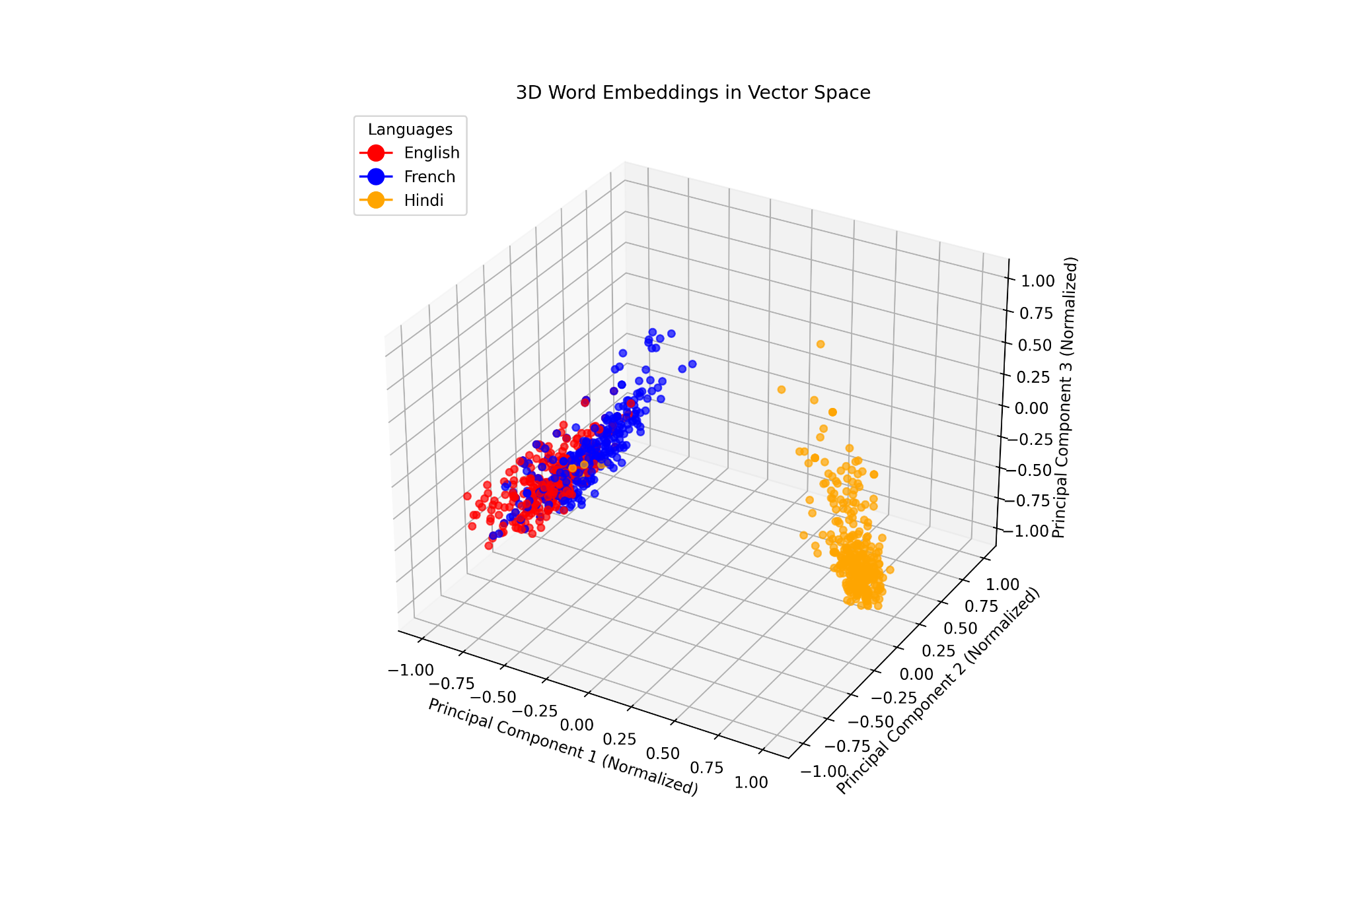
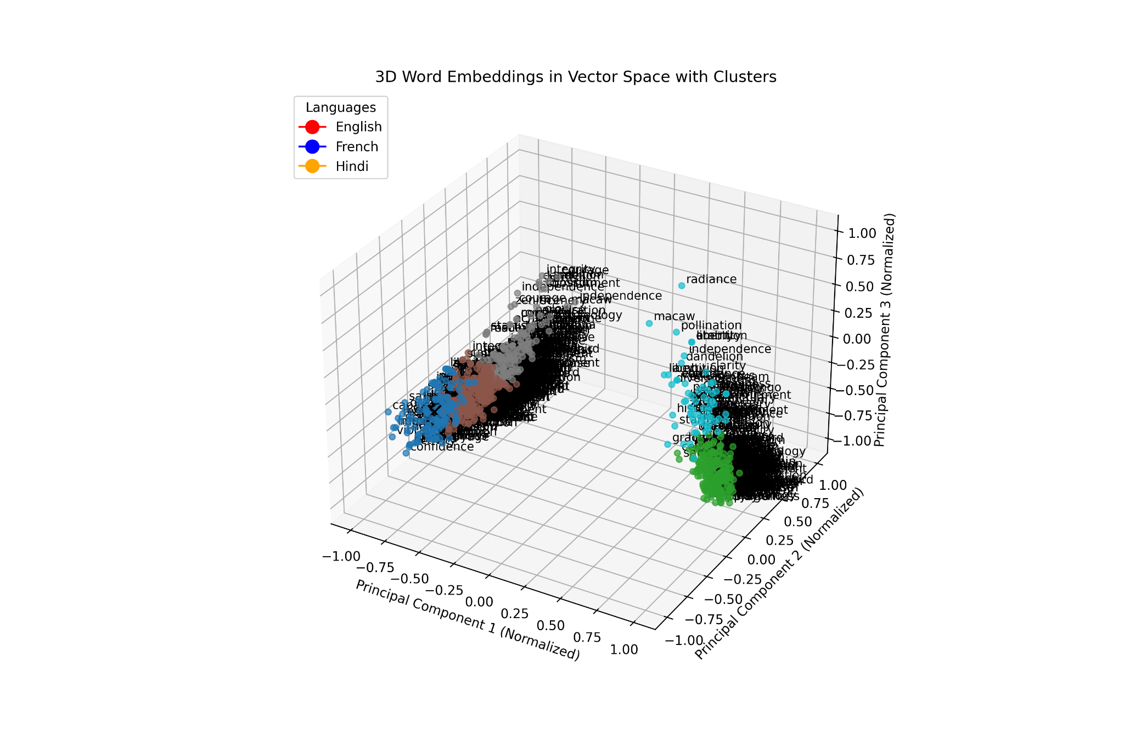
Task-1
Tony Stark
We investigate the multilingual semantic alignment in
BLOOM-1.7B by examining word embeddings of semantically identical words across three languages: English, French, and Hindi.

Slide 5
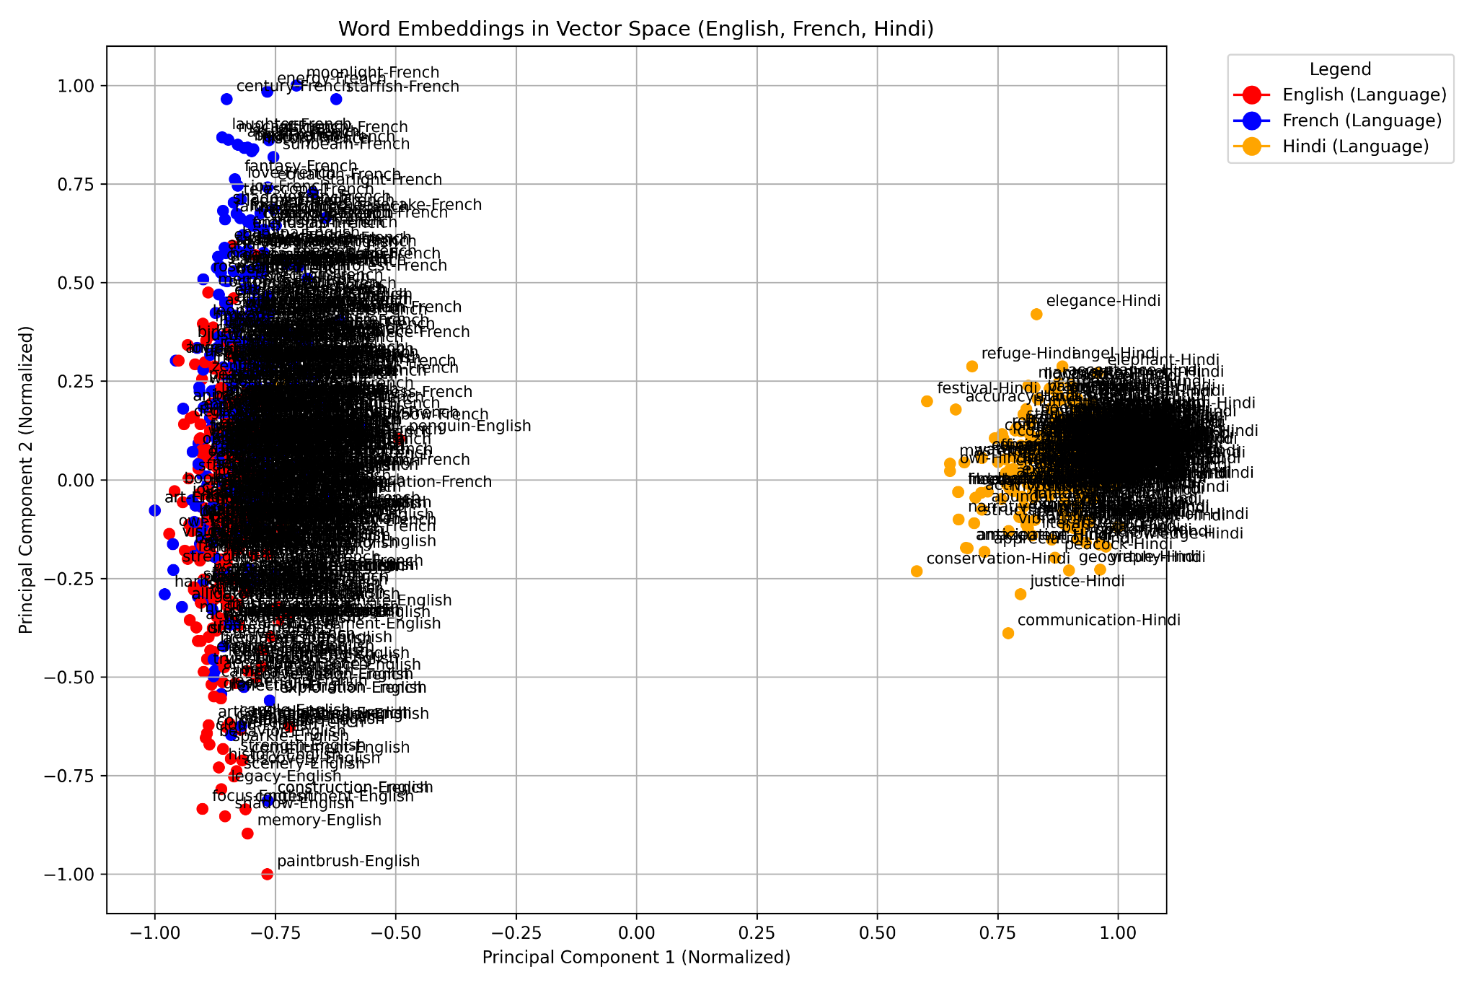
Task-1
Tony Stark
2D PCA Plots and 3D PCA Plots

Slide 6

Task-1
Tony Stark
Findings:
English and French are closer in embedding space
Hindi being from an Indic class of languages has a different embedding space
2D PCA Plots and 3D PCA Plots

Slide 7
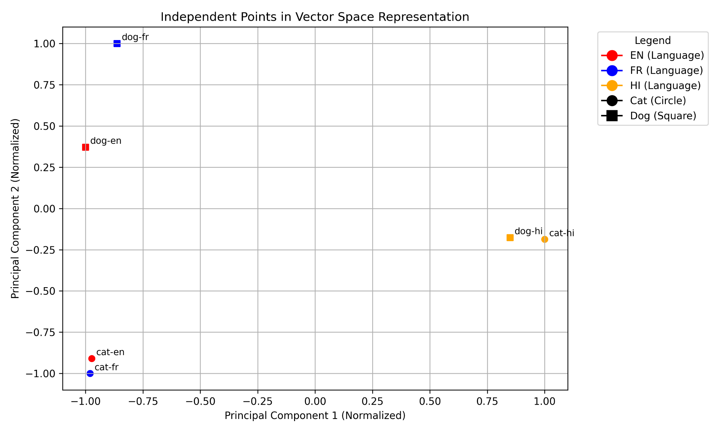
Task-1
Tony Stark
Independent points in vector space

Slide 8
Task-1
Tony Stark
Findings:
English and French embeddings for "cat" and "dog" are close, with "cat" being particularly similar.
Hindi embeddings lie far from English and French, reflecting its distinct language family.

Slide 9
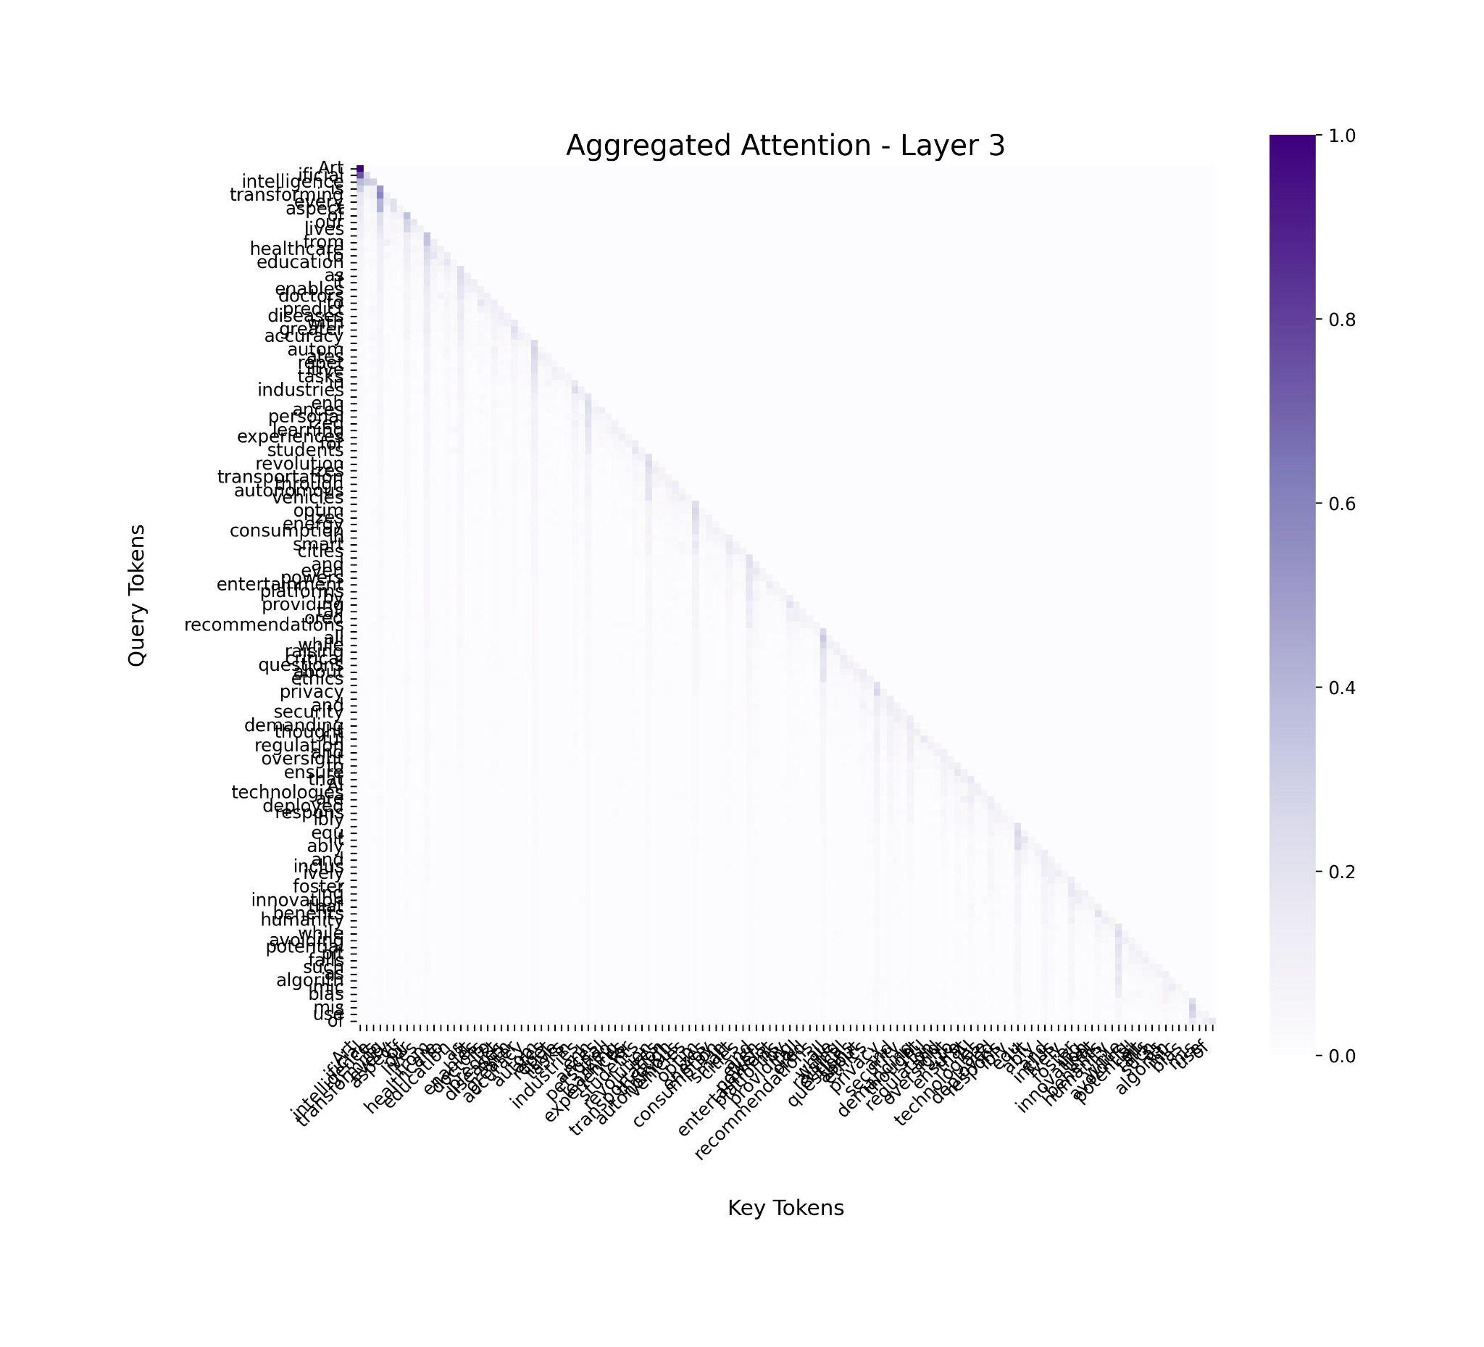
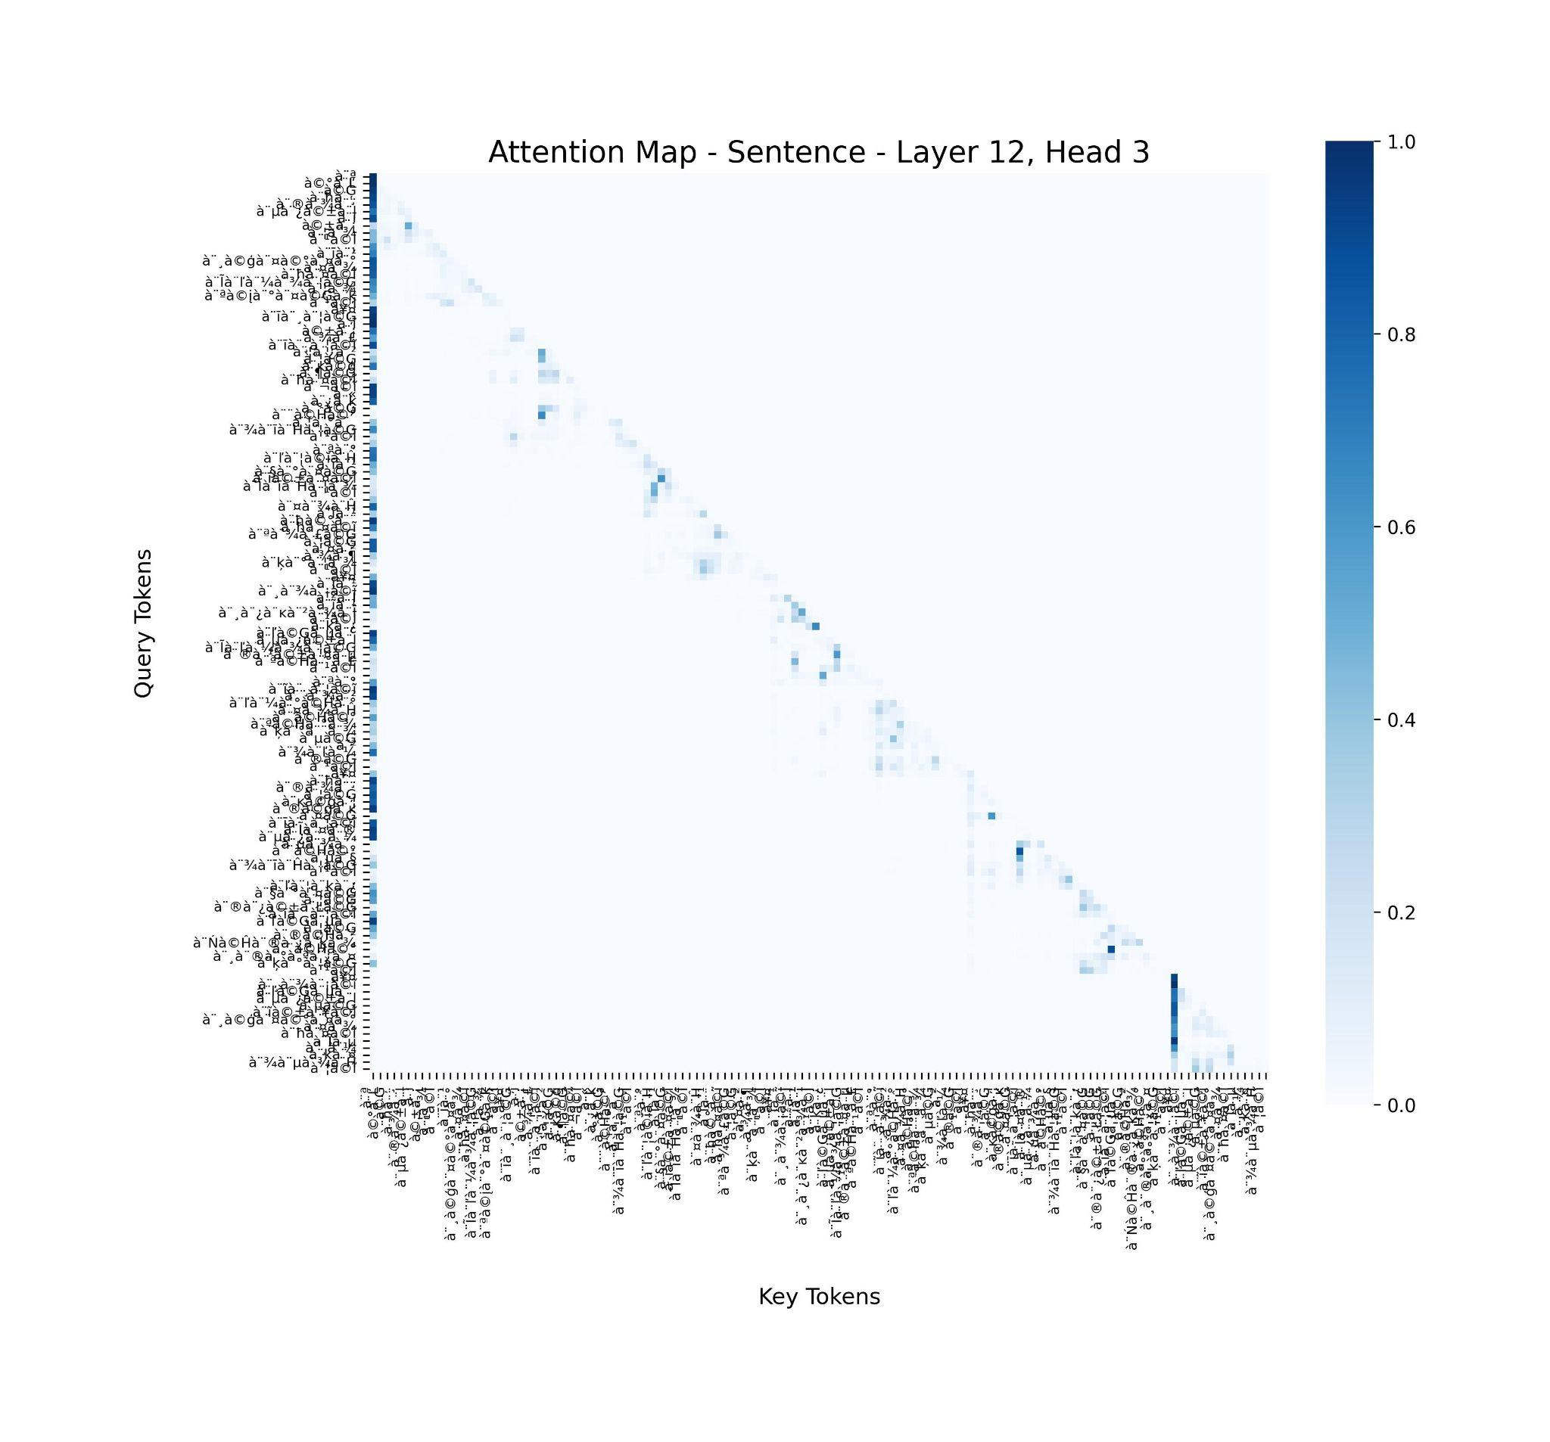
Task-2
Tony Stark
This task explores the internal workings of BLOOM-1.7B
by visualizing attention maps and employing hooking tech-
niques to understand the role of individual layers and their
contribution to the model’s overall performance.
Two types of attention visualizations were produced:
• Single-Head Attention Maps: These maps illustrate
the attention weights for individual heads, highlight-
ing token-to-token relationships.
• Aggregated Attention Maps: These maps combine
attention weights across all heads in a layer, providing
a holistic view of the layer’s focus

Slide 10
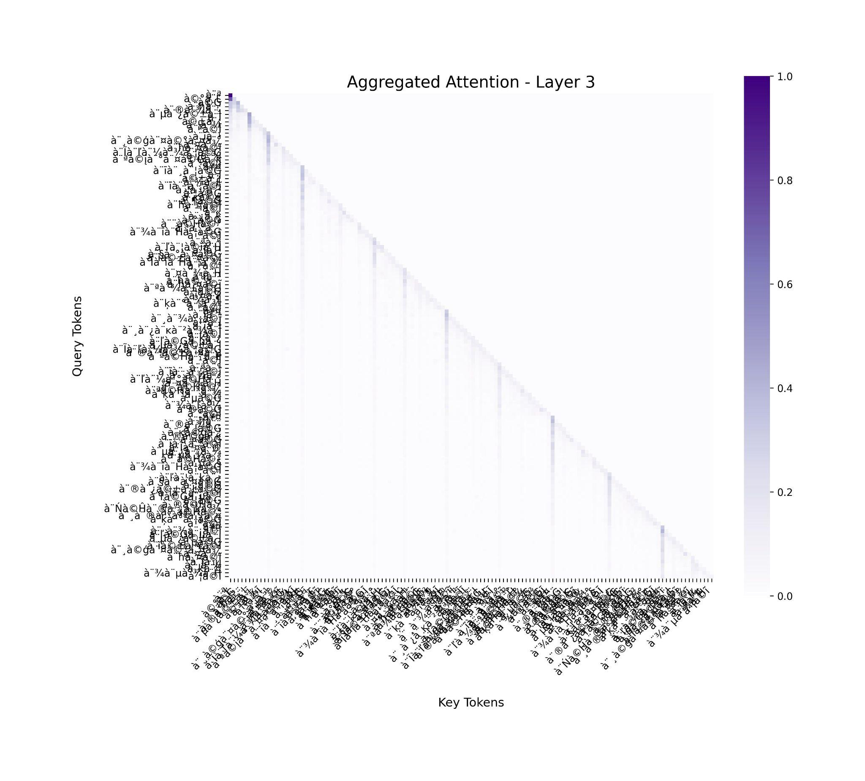

Task-2
Tony Stark
Attention Maps:=> Punjabi (Gurumukhi) Agg Attn and Layer-Headwise

Slide 11
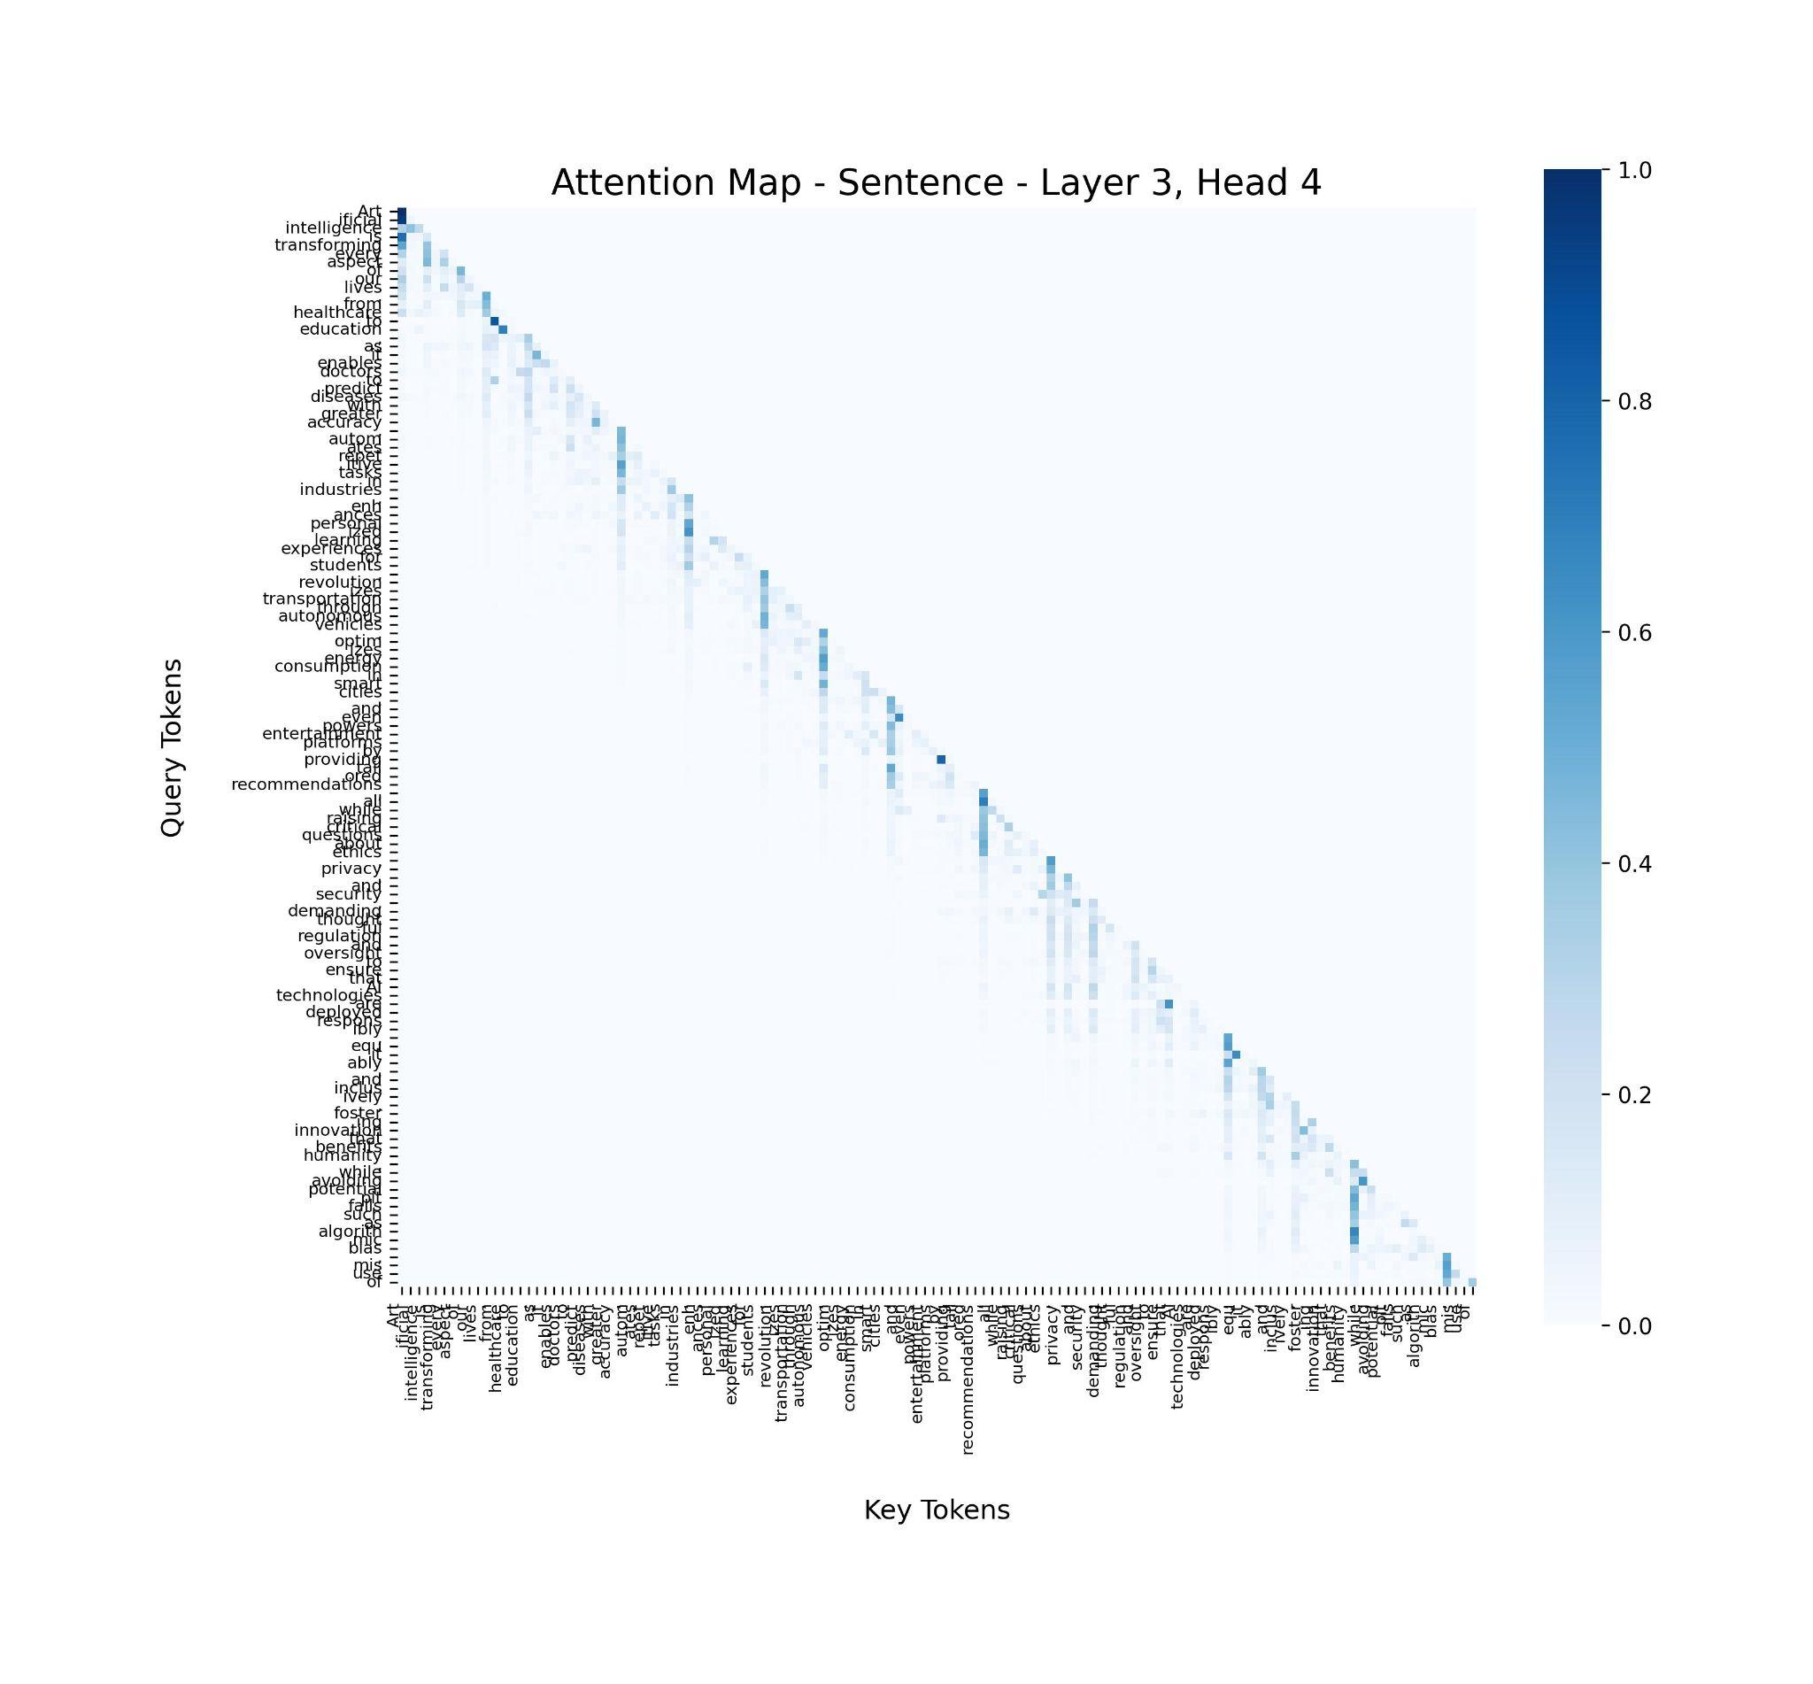
Task-2
Tony Stark
Attention Maps:=> English Agg Attn and Layer-Headwise

Slide 12
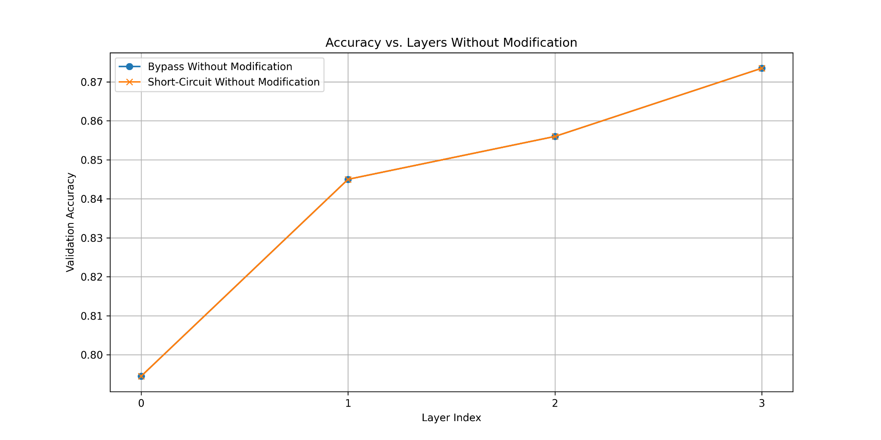
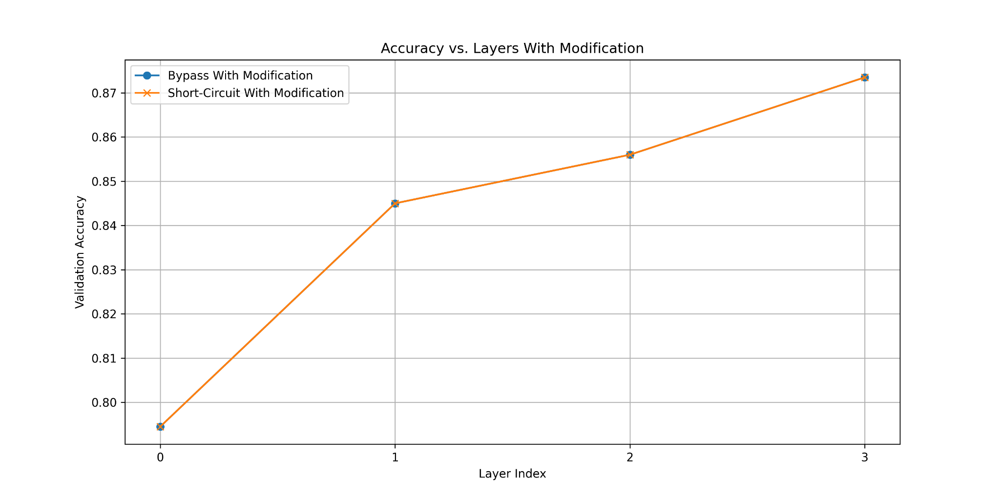
Task-2
Tony Stark
To understand the role of individual layers in BLOOM-1.7B, probing techniques were employed using transformer hooking mechanisms.
Two types of attention visualizations were produced:
• Bypassing Layers: It involves bypassing a specific layer by equating its output to the previous layer's output. It helps analyze the contribution of the bypassed layer to the model's performance.
•Short-Circuiting Layers: It involves zeroing out the outputs of a specific layer to measure its impact on downstream tasks. It allows us to identify the importance of the layer for specific tasks.

Slide 13
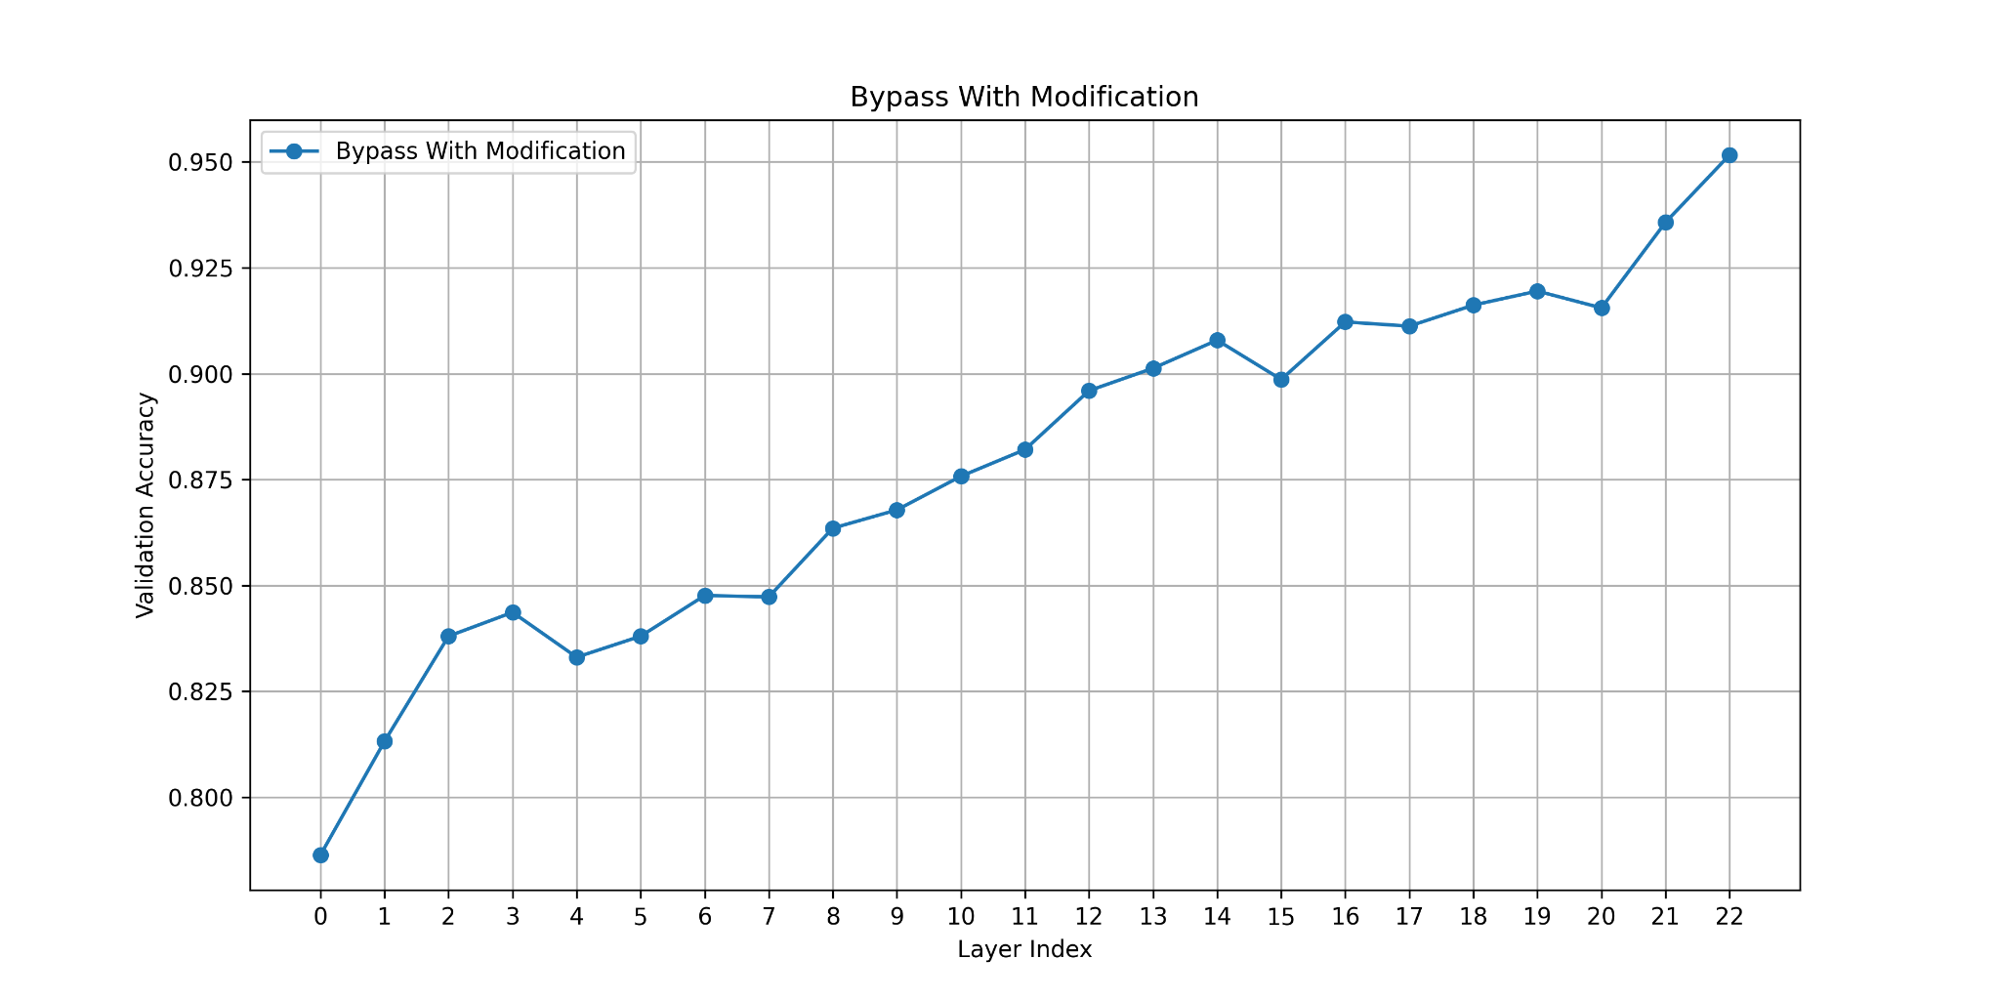
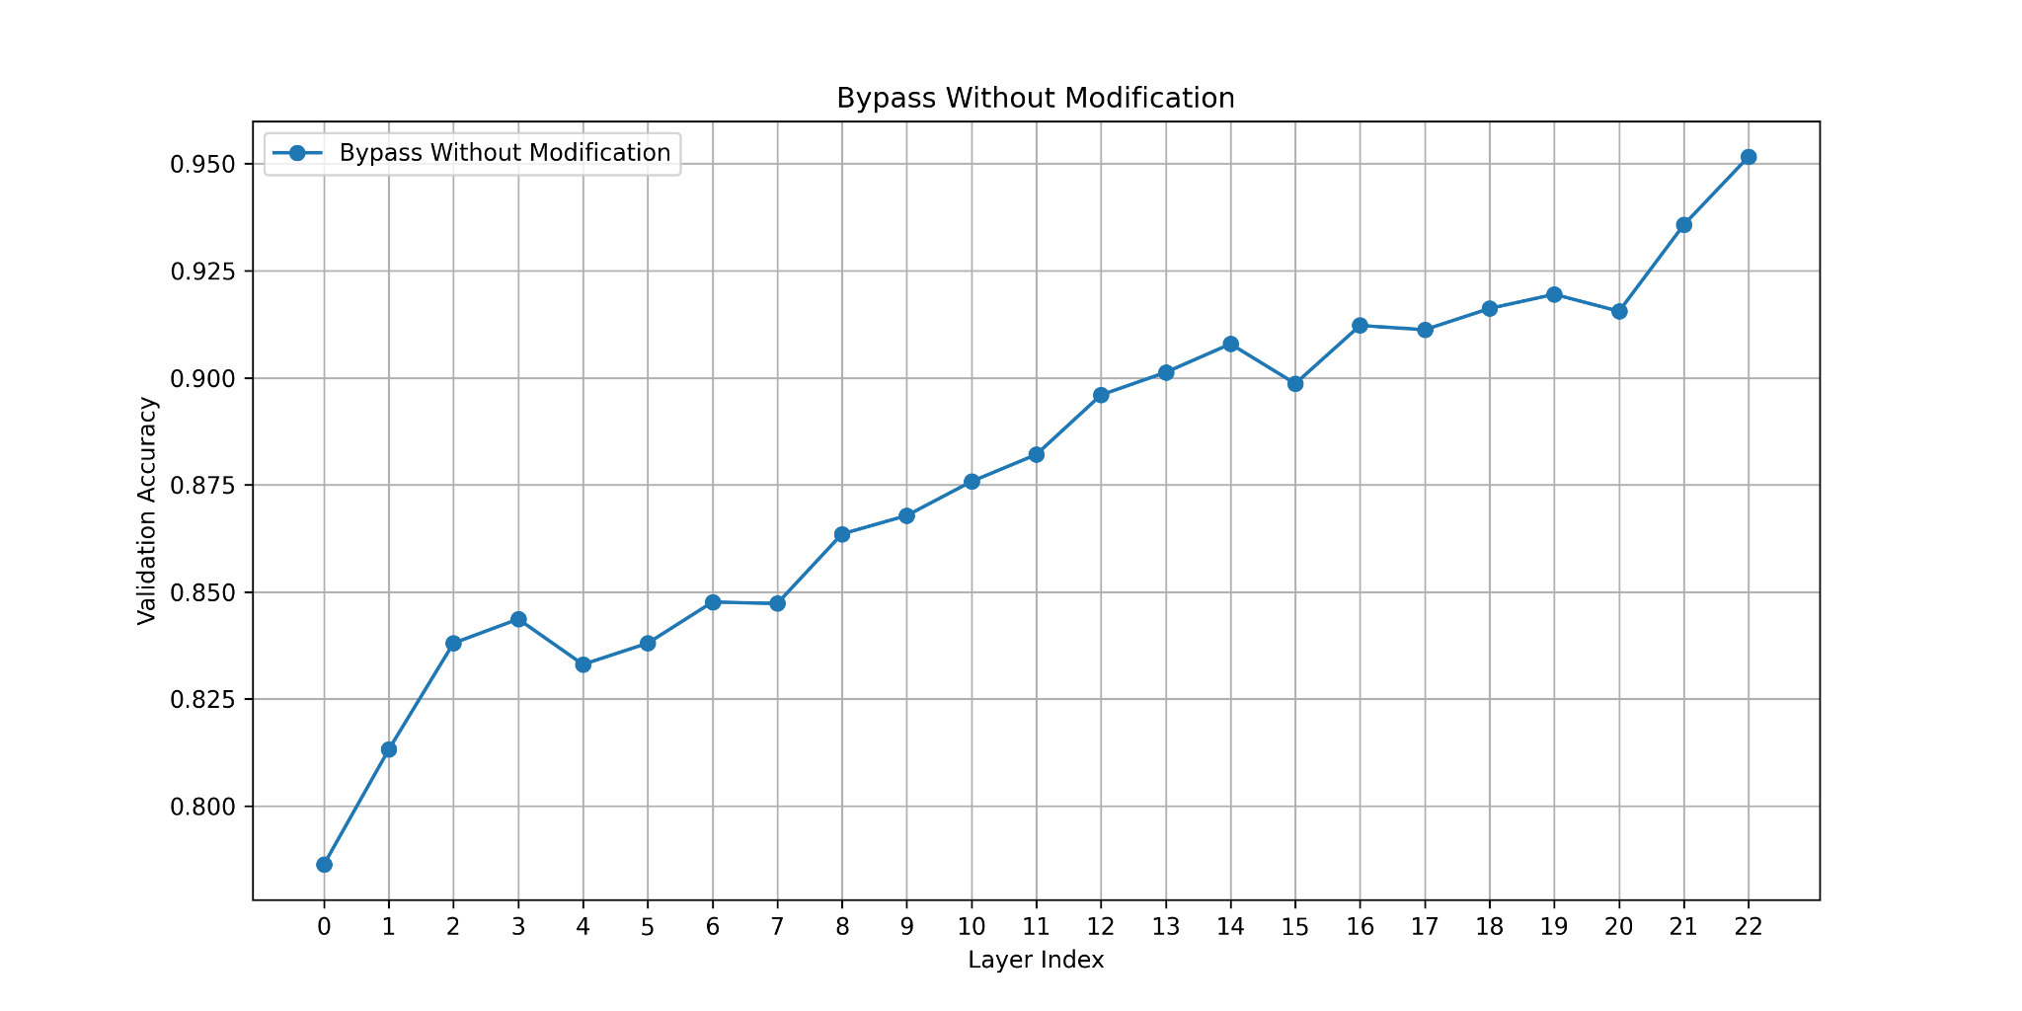
Task-2
Tony Stark
By passing:=> With and Without Modification

Slide 14
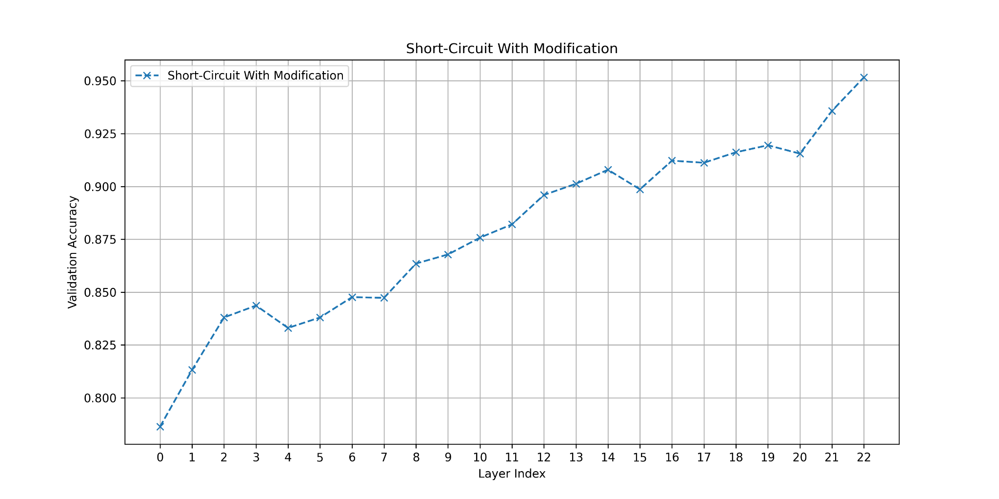
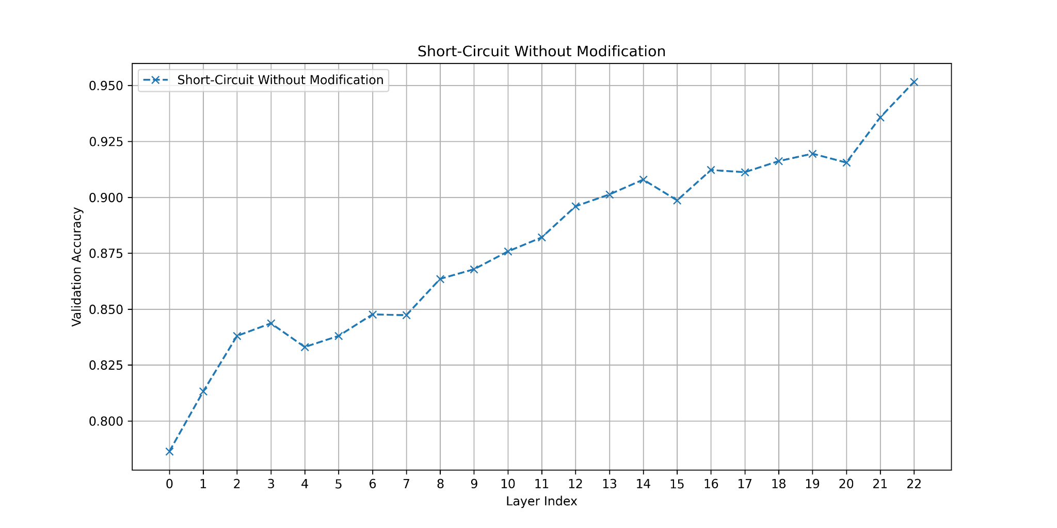
Task-2
Tony Stark
Short Circuiting:=> With and Without Modification

Slide 15
Task-2
Tony Stark
Findings:
One critical observation is that as we hook into deeper layers of the model, the hidden states become more and more enriched which is evident from increasing accuracies across layers hooks.

Slide 16
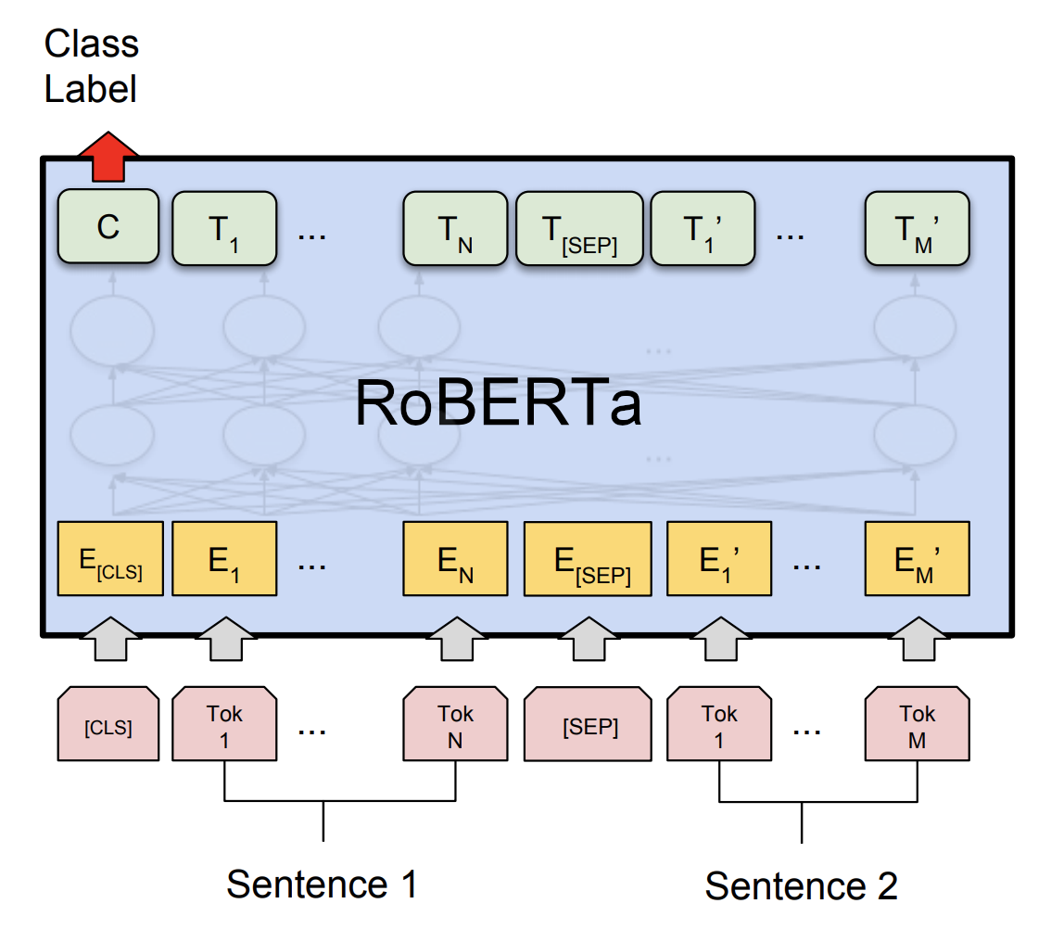

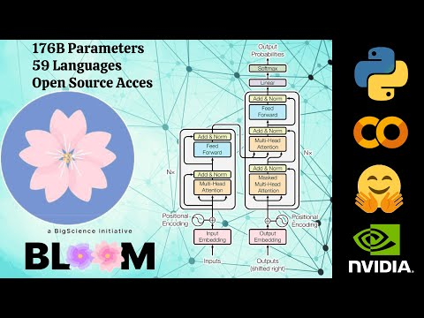
Task-3
Tony Stark
In this task, three models—BLOOM-1.7B, RoBERTa, and IndicBERT—were fine-tuned on English and evaluated on Bengali and Gujarati datasets.
Three models were fine-tuned in as experiments
• Bloom 1.7B [with QLoRA]
• RoBERTa
• IndicBERT

Slide 17
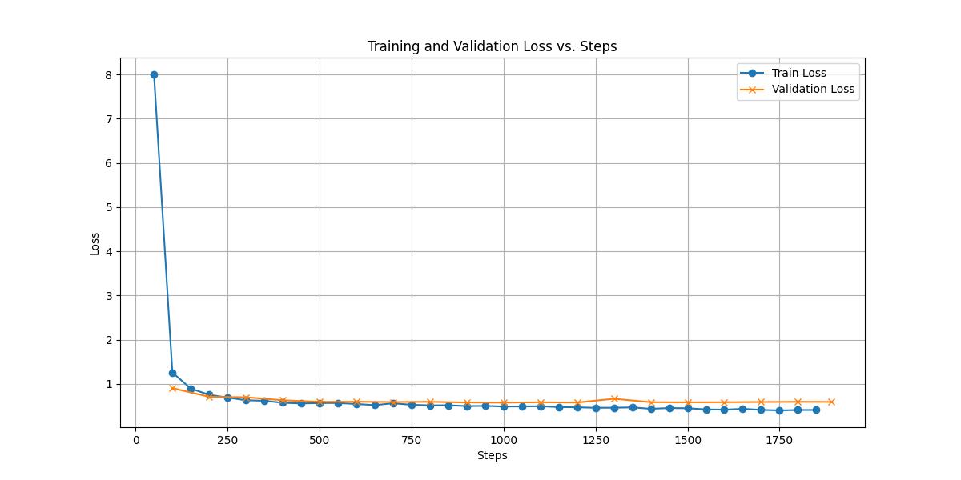
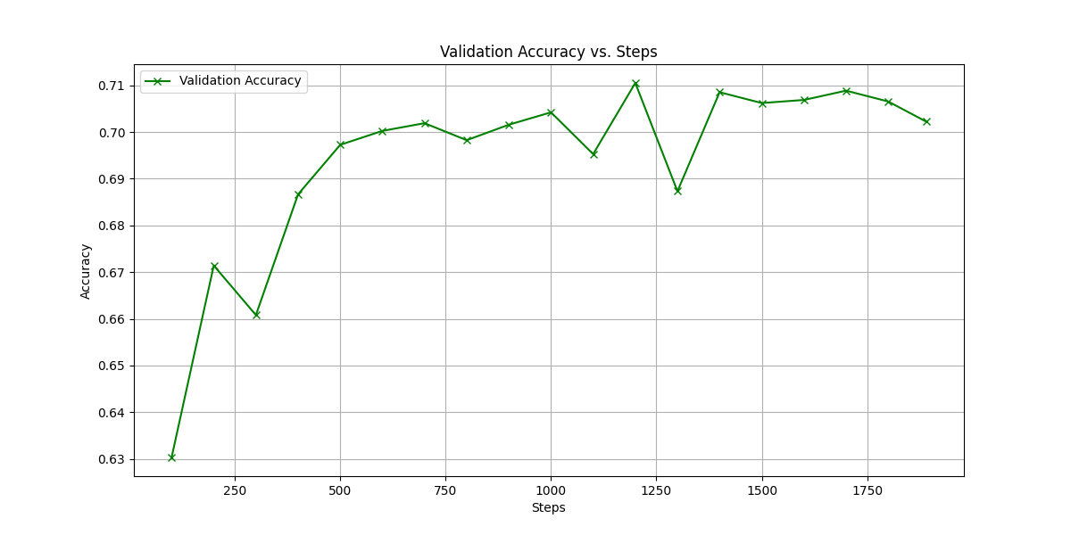
Task-3
Tony Stark
Loss and Accuracy Plots Bengali (Bloom 1.7B+QLoRA)

Slide 18
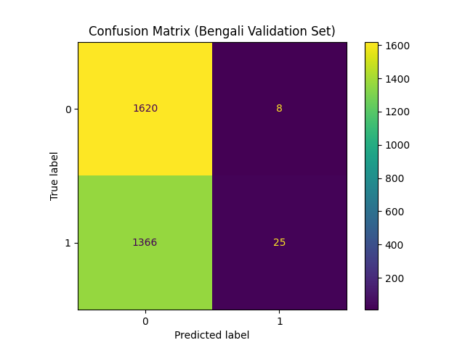
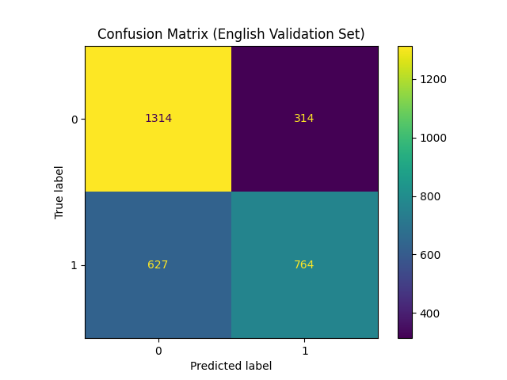
Task-3
Tony Stark
Confusion Matrix Bengali (Bloom 1.7B+QLoRA)

Slide 19
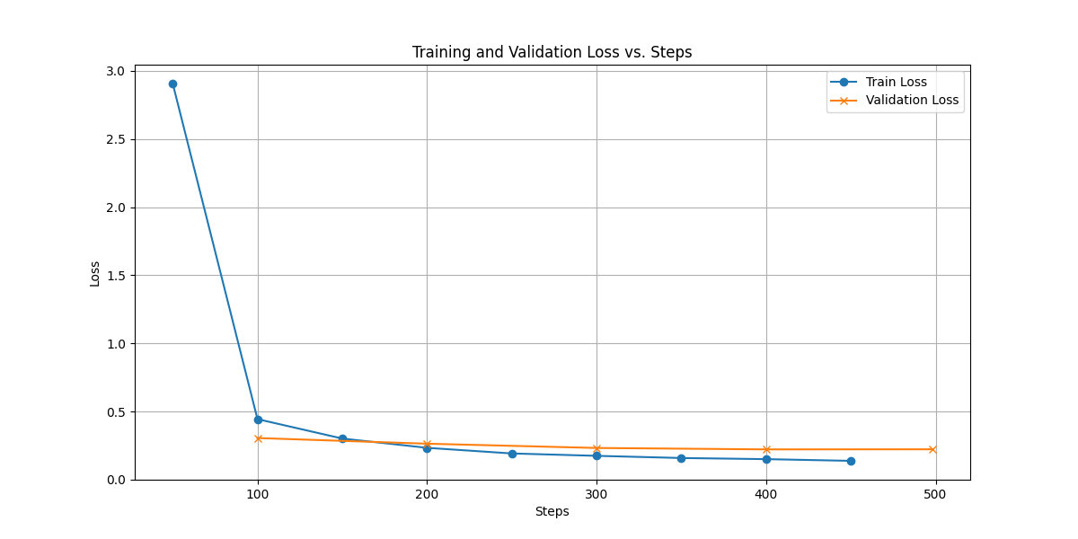
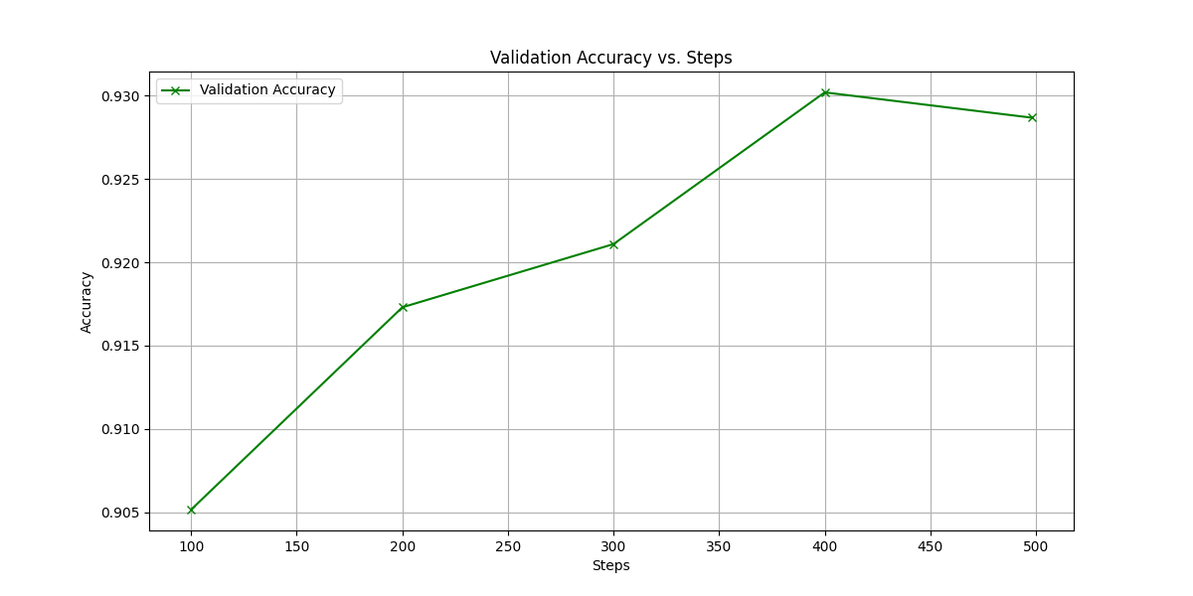
Task-3
Tony Stark
Loss and Accuracy Plots - Gujarati(Bloom 1.7B+QLoRA)

Slide 20
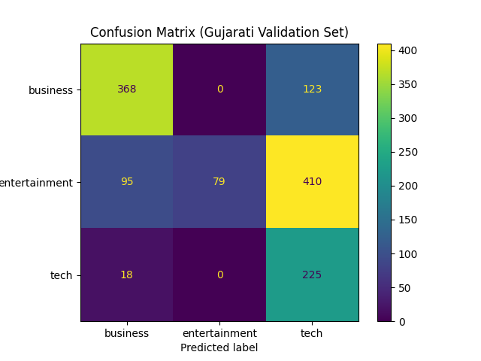
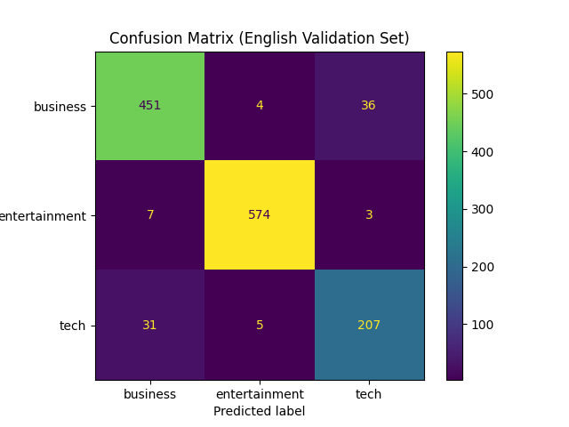
Task-3
Tony Stark
Confusion Matrix Bengali (Bloom 1.7B+QLoRA)

Slide 21
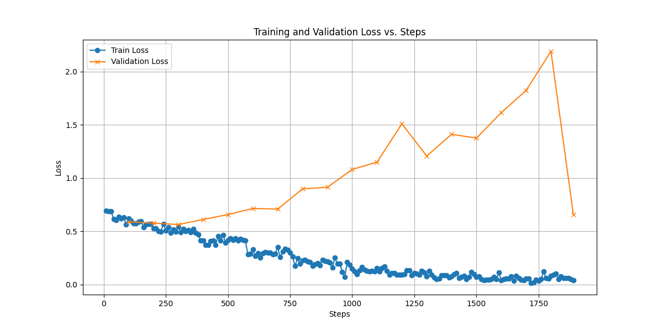
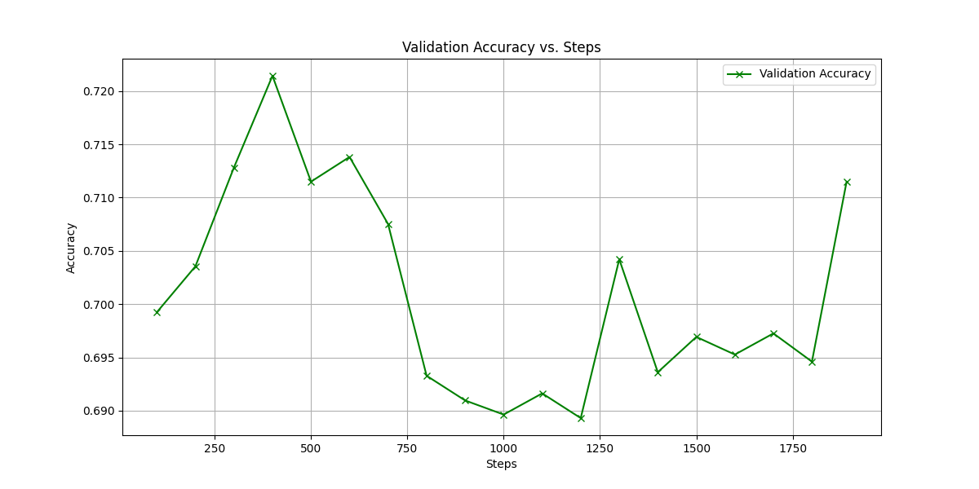
Task-3
Tony Stark
Loss and Accuracy Plots Bengali (RoBERTa)

Slide 22
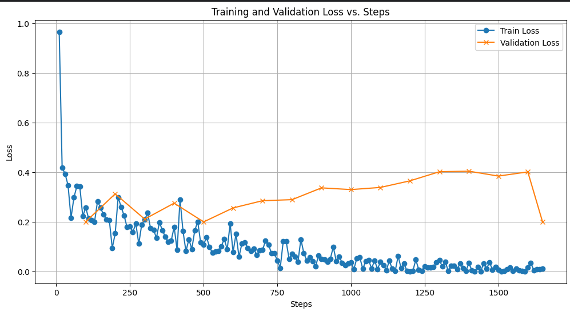
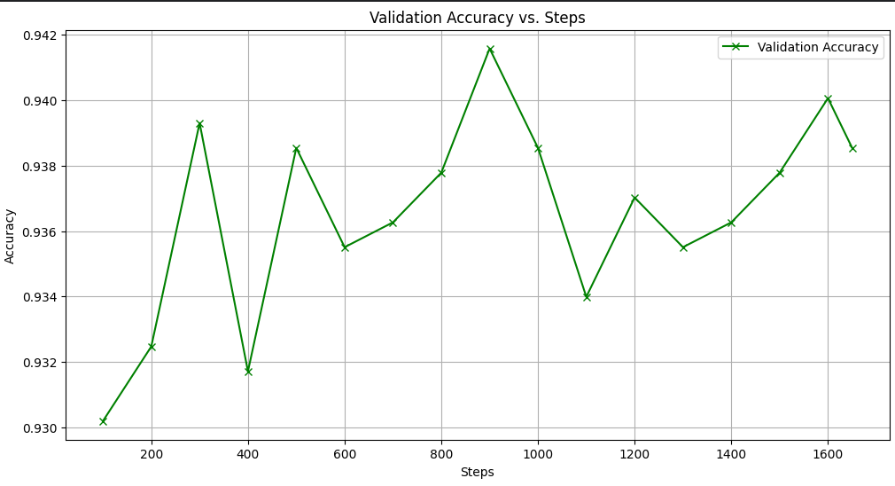
Task-3
Tony Stark
Loss and Accuracy Plots Gujarati (RoBERTa)

Slide 23
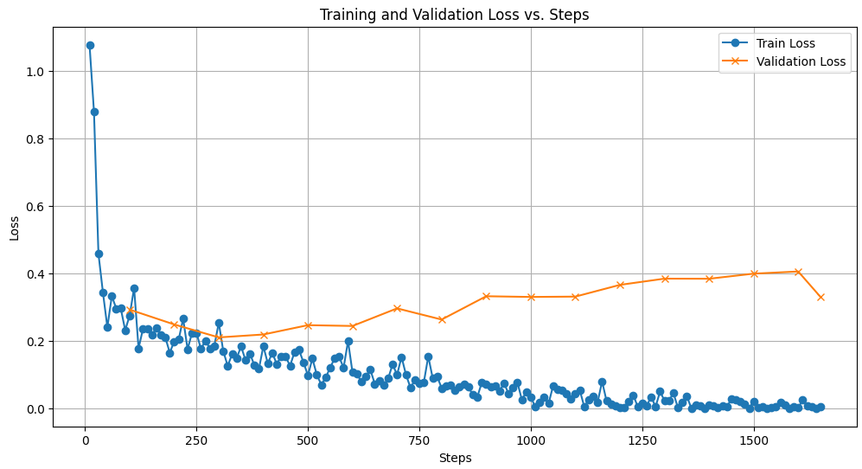
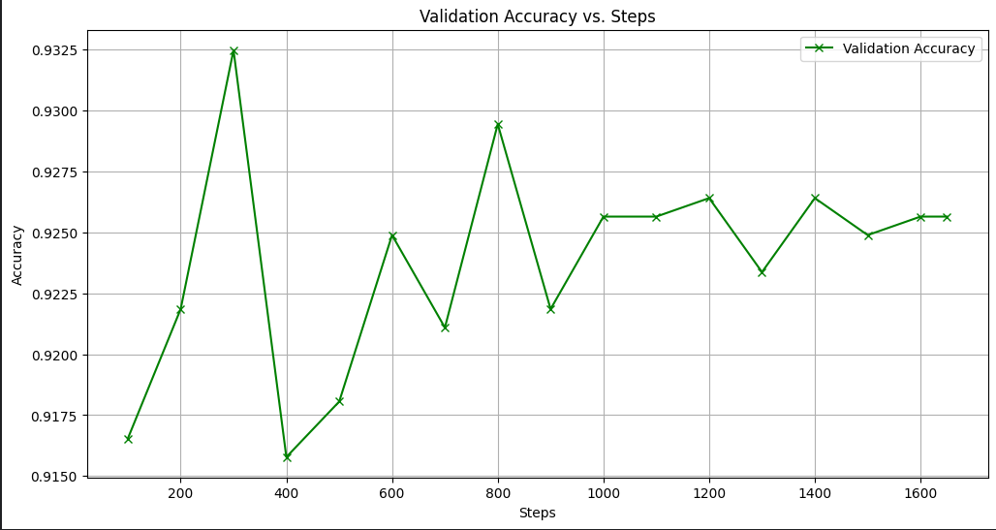
Task-3
Tony Stark
Loss and Accuracy Plots - Gujarati (IndicBERT)

Slide 24
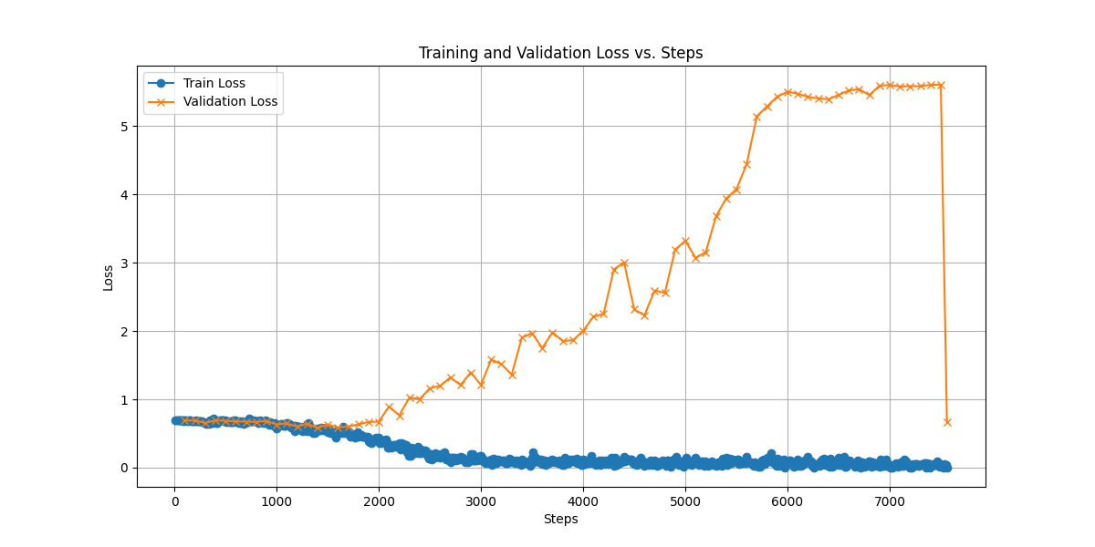
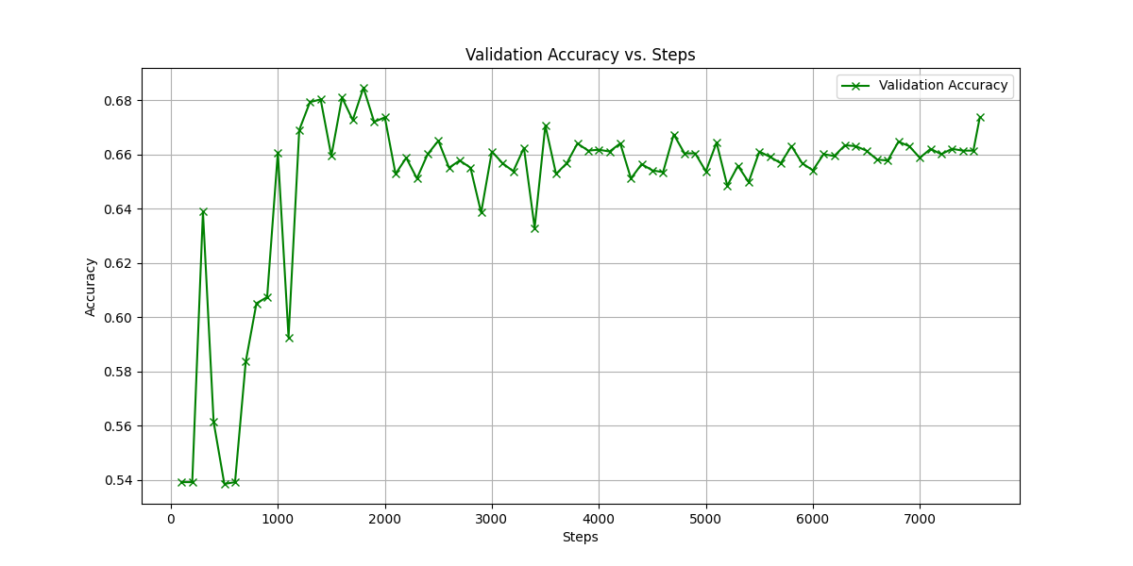
Task-3
Tony Stark
Loss and Accuracy Plots Bengali (IndicBERT)

Slide 25
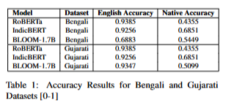
Task-3
Tony Stark
Final Accuracy Results

Slide 26
Task-3
Tony Stark
Findings:
Training Data Bias: Richer English corpora vs. low-resource Bengali and Gujarati datasets.
Language Complexity: Morphological richness and distinct scripts (Bengali, Gujarati).
Model Pretraining: BLOOM/RoBERTa favor high-resource languages; IndicBERT excels in Indic languages.
Cross-Lingual Limitations: Structural differences hinder transferability.
Dataset Size: Smaller fine-tuning datasets for Bengali/Gujarati.
Task Complexity: Gujarati's 3-class task more challenging than Bengali's binary classification.

Slide 27
Future Scope and Improvements
Potential Areas of Improvements:
In Task-2, my probing currently is giving same outputs whether I short circuit it or bypass it. Will try to look it.
Also will try to visualize eigenvectors of attention maps so as to uncover more structural patterns.
Will also train Bloom 1.7B model for more epochs if the val loss decreases more

Slide 28

Thank You
Shashwat Bhardwaj
2023AIY7528
Team: Tony Stark

